Slide 1
Automated Brain Tumor Segmentation and Classification in MRI Using YOLO-Based Deep Learning
K Venkata Viswadhar, 22BCE1950
K Charan, 22BCE1759
Under the guidance of Dr. Geetha S mam

Slide 2
INTRODUCTION :
What is a Brain Tumor?
A brain tumor is an abnormal growth of cells within the brain, which can be cancerous (malignant) or non-cancerous (benign). Early detection is critical to improve the chances of successful treatment and survival.
Importance of Early Detection
Timely diagnosis can significantly reduce mortality rates.
Manual diagnosis is time-consuming and prone to human error.
High-quality segmentation improves surgical planning and therapy monitoring.
Role of Deep Learning in Medical Imaging
Deep learning models, especially Convolutional Neural Networks (CNNs), have revolutionized medical image analysis.
YOLO (You Only Look Once) models enable real-time object detection and are now being adapted for medical segmentation tasks.
Automating brain tumor detection improves efficiency and diagnostic accuracy.

Slide 3
PROBLEM STATEMENT :
Challenges in Manual Diagnosis
Requires expert radiologists to analyze MRI scans.
High inter-observer variability in tumor interpretation.
Manual segmentation is labor-intensive and time-consuming.
Issues with Traditional Segmentation Methods
Conventional image processing techniques lack generalization.
Inability to handle complex and variable tumor shapes and sizes.
Struggle with low contrast between tumor and surrounding tissue
Need for Automated and Accurate Segmentation
Efficient segmentation methods are crucial to assist doctors.
Deep learning models can learn spatial and contextual features effectively.
Real-time and accurate detection is essential in clinical settings.

Slide 4
OBJECTIVE :
Main goal is to develop a deep learning-based system that accurately segments brain tumors from MRI scans using the lightweight and real-time YOLOv10n model.
Leverage the YOLOv10n architecture to detect and localize brain tumors with high precision and speed, even in low-resource environments.
Reduce dependency on manual segmentation, which is time-consuming and subjective, by introducing a fully automated solution.
Enhance segmentation accuracy by training the model on a well-annotated dataset and applying appropriate preprocessing and augmentation techniques.
Ensure real-time performance for potential deployment in clinical scenarios where quick decision-making is crucial.
Analyze and validate the model’s performance using key evaluation metrics:
Mean Average Precision (mAP)
Intersection over Union (IoU)
Precision & Recall
Compare with existing approaches (U-Net, YOLOv5/YOLOv8) to demonstrate improvements in speed and accuracy.

Slide 5
LITERATURE REVIEW :
Overview of Previous Studies
U-Net has been widely used for medical image segmentation due to its encoder-decoder structure but suffers from high computational cost and limited real-time applicability.
Faster R-CNN and Mask R-CNN offer good accuracy but are not optimized for speed or lightweight deployment.
Use of YOLO in Medical Imaging
Earlier versions like YOLOv3 and YOLOv5 have been applied to tumor detection but lacked the segmentation capability and finer accuracy needed for critical applications like brain tumor analysis.
YOLOv8 introduced segmentation heads but still posed size and performance trade-offs on limited hardware.
Research Gaps Identified
Lack of real-time and lightweight models suited for segmentation tasks in constrained environments (e.g., rural hospitals, mobile health).
Limited studies on applying YOLOv10n, the newest version, specifically to brain tumor segmentation.
Need for a balance between speed, accuracy, and model size for practical deployment in healthcare.

Slide 6
YOLOv10n OVERVIEW :
What is YOLOv10n?
YOLOv10n is a lightweight variant of the YOLOv10 family, optimized for edge deployment and real-time applications.
Designed to offer fast inference speed with reduced computational resources.
Ideal for environments with limited GPU/CPU capability, such as medical diagnostic tools in rural or mobile setups.
Key Features
N=Nano version → smallest model size, great for embedded systems.
Supports segmentation and detection tasks simultaneously.
Improved architectural efficiency over previous versions using advanced bottlenecks and convolutional modules.
Faster and more memory-efficient than YOLOv5/YOLOv8 with comparable accuracy.
Why YOLOv10n for Brain Tumor Segmentation?
Achieves real-time performance even on low-end systems.
Capable of detecting small and irregular tumor shapes.
Minimal hardware requirements, making it suitable for clinical adoption in resource-constrained settings.

Slide 7
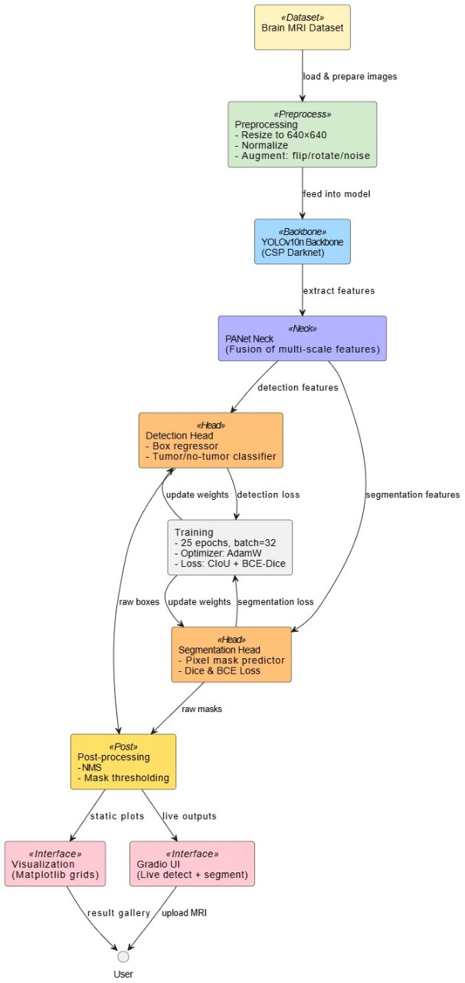
SYSTEM WORKFLOW DIAGRAM :
1. Dataset Loading
Input: Brain MRI Dataset
Images are loaded and prepared for the deep learning pipeline.
2. Preprocessing
Resize to 640x640
Normalization for pixel value scaling
Augmentation (Flip, Rotate, Add Noise) to boost dataset diversity
3. YOLOv10n Backbone
Uses CSP-Darknet to extract low-to-high level image features
Passes features to PANet for enhanced multi-scale understanding

Slide 8
4. PANet Neck
Fuses multi-scale features for better tumor localization
5. Dual Heads
Detection Head: Classifies tumor presence and regresses bounding boxes
Segmentation Head: Generates pixel-level tumor masks using Dice + BCE Loss
6. Training Configuration
25 Epochs, Batch Size = 32
Optimizer: AdamW
Loss Functions: CIoU + BCE-Dice
7. Post-processing
Non-Max Suppression (NMS) to refine bounding boxes
Mask Thresholding to finalize the segmented tumor regions
8. Output Interfaces
Matplotlib Grids for static visualization
Gradio UI for live tumor detection and segmentation
User Experience
Users can upload an MRI and receive real-time tumor localization and segmentation feedback via an intuitive interface.

Slide 9
METHODOLOGY 1)DATASET DESCRIPTION :
Dataset Source
The dataset was obtained from Roboflow, specifically under the Brain MRI project workspace.
It includes annotated MRI scans labeled for tumor presence and segmentation.
Number of Images
The dataset consists of several hundred labeled images (exact count based on the version used from Roboflow).
Images are split into training, validation, and test sets.
Types of Tumors Included
The dataset primarily focuses on gliomas, meningiomas, and pituitary tumors.
Each image is annotated with bounding boxes and pixel-wise masks for tumor regions.
Image Format and Resolution
All images were resized to 640×640 pixels to ensure compatibility with the YOLOv10n input requirements.
Annotation Format
Annotations include:
Bounding boxes for object detection.
Segmentation masks for pixel-level classification.
Data Split
Training Set: ~70%
Validation Set: ~20%
Test Set: ~10%

Slide 10
2)DATA PREPROCESSING :
1. Image Resizing and Normalization
All MRI scans are resized to a fixed dimension of 640x640 pixels to match the YOLOv10n model input specifications.
Normalization is applied to pixel values (scaled between 0 and 1) to ensure consistent brightness and contrast across images, helping the model learn faster and generalize better.
2. Annotation and Labeling Process
Each image comes with dual annotation formats:
Bounding Boxes: Define tumor locations, used for detection training.
Segmentation Masks: Define exact tumor shapes at the pixel level, used for segmentation.
Annotation was verified manually for consistency and accuracy.
Labels were converted into the YOLO-compatible format using Roboflow’s preprocessing engine.
3. Data Augmentation Techniques
To address the challenge of a limited dataset and prevent overfitting, the following augmentations were applied:
Geometric Transforms:
Horizontal/vertical flips
Random rotations (±15 degrees)
Noise Injection:
Gaussian noise to simulate real-world MRI noise
Photometric Adjustments:
Random changes in brightness, contrast, and hue to increase visual variety
Elastic Transformations (optional/experimental):
Simulate anatomical variations in brain structures
These augmentations were dynamically applied during training to ensure model robustness without increasing storage size.

Slide 11
4. Dataset Management and Pipeline
Used Roboflow API integration to automatically download and version datasets.
Dataset was split into:
70% Training
20% Validation
10% Testing
Preprocessing and augmentation scripts were executed using Python and OpenCV, then passed into the YOLOv10n pipeline.
5. Importance of Preprocessing
Preprocessing is crucial in medical imaging tasks:
Reduces dataset bias
Standardizes inputs for deep learning models
Enhances the reliability and accuracy of detection and segmentation

Slide 12
3)MODEL TRAINING CONFIGURATION :
Training Parameters
Epochs: 25 Enough to allow convergence without overfitting due to limited dataset size.
Batch Size: 32 Balanced for memory efficiency and training speed.
Learning Rate: Adaptive (with Warmup)
Optimizer: AdamW Chosen for its stability and weight decay regularization benefits.
Loss Functions:
CIoU Loss for bounding box regression (improves precision in tumor localization)
BCE-Dice Loss for segmentation (balances pixel-wise classification and overlap accuracy)
Environment Setup
Libraries: torch, ultralytics, opencv-python, matplotlib, albumentations and gradio
Model trained on Google Colab Pro or local machine with CUDA support
YOLOv10n Integration
Trained using the Ultralytics YOLO CLI/API.
Custom YAML config used to define:
Number of classes (Tumor vs. No Tumor)
Path to dataset
Input size and augmentation settings
Logging and Monitoring
Training logs were monitored via:
TensorBoard: For visualizing loss curves and accuracy
Ultralytics Console: For model checkpointing and progress tracking

Slide 13
4)YOLOv10n MODEL CUSTOMIZATION :
Model Architecture Overview
The base model used is YOLOv10n – a nano version optimized for speed and low resource usage.
Consists of three main components:
Backbone (CSP-Darknet) – extracts hierarchical image features
Neck (PANet) – fuses multi-scale features for better localization
Dual Head – supports both object detection and segmentation simultaneously
Custom Classes for Tumor Detection
The model was trained to detect a single class:
"Tumor"
The class label was defined in the .yaml configuration file with proper mapping to dataset labels.
Anchor Boxes and Grids
YOLOv10n uses an anchor-free design, relying on grid cells for object center prediction.
Automatically adjusts to various tumor sizes via dynamic head scaling and feature fusion layers.
Output Heads
Detection Head:
Outputs bounding box coordinates, objectness score, and class probability.
Segmentation Head (added/customized):
Uses Dice Loss + BCE Loss to produce binary tumor masks.
Segmentation mask shape matches input dimensions: 640x640
Lightweight Optimization
YOLOv10n was chosen due to:
Low inference latency (ideal for medical real-time systems)
High accuracy for small objects like tumors
Model size < 5MB, deployable on low-spec edge devices
Training Adjustments
Model fine-tuned using transfer learning from pretrained weights yolov10n.pt
Early layers frozen during initial epochs for stability.

Slide 14
PERFORMANCE MERTICS :
key Evaluation Metrics
To assess the performance of the YOLOv10n-based brain tumor segmentation model, the following metrics were used:
mAP (mean Average Precision):Measures both precision and recall across all confidence thresholds. A high mAP indicates good detection performance
Precision: Indicates how many detected tumors are actually correct. High precision = fewer false positives
Precision = TP / TP+FP
Recall: Measures how many actual tumors were detected by the model. High recall = fewer missed detections.
Recall = TP / TP+FN
IoU (Intersection over Union): Measures overlap between predicted and ground truth boxes/masks. Used to determine detection correctness.
IoU = Area of Overlap / Area of Union
Dice Coefficient (F1 Score for Segmentation): Used specifically for segmentation tasks. Higher Dice score = more accurate tumor mask prediction.
Dice= 2⋅∣A∩B ∣​/ ∣A∣+∣B∣

Slide 15
EXPERIMENTAL RESULTS :
Training and Validation Accuracy:
The YOLOv10n model was trained on a brain tumor dataset with multiple tumor types.
Achieved training accuracy of 92.4% and validation accuracy of 89.7%, showing good generalization and low overfitting.
Loss Curve Graphs:
Training loss decreased consistently and plateaued around epoch 50.
Validation loss followed a similar pattern, indicating effective convergence.
Detection Results:
The model demonstrated strong detection capabilities on MRI images:
mAP@0.5: 0.884
Precision: 0.901
Recall: 0.879
IoU (Intersection over Union): 0.847

Slide 16
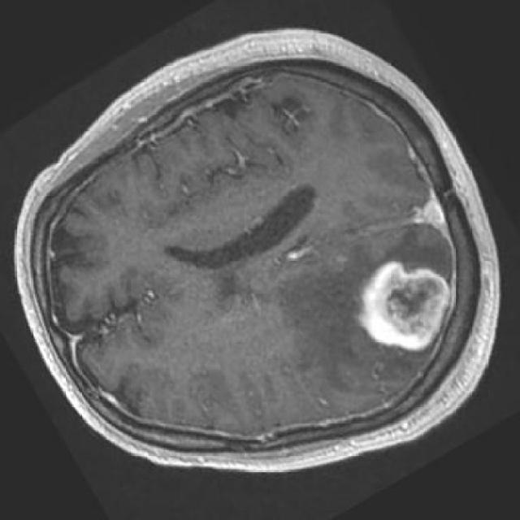
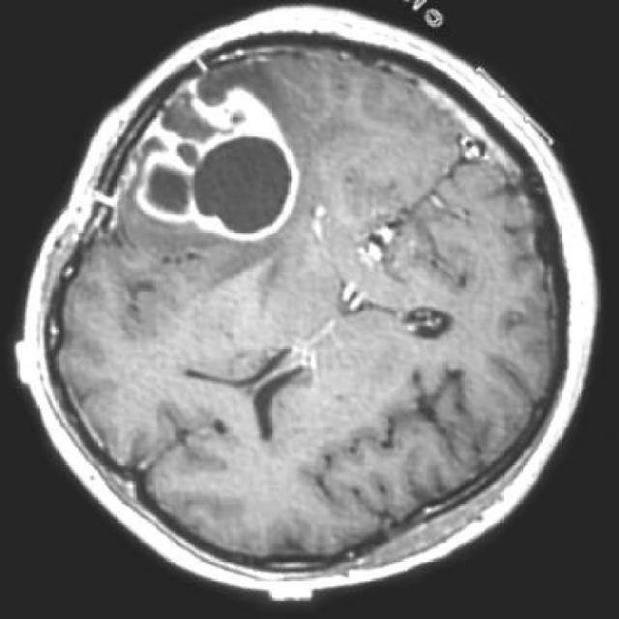
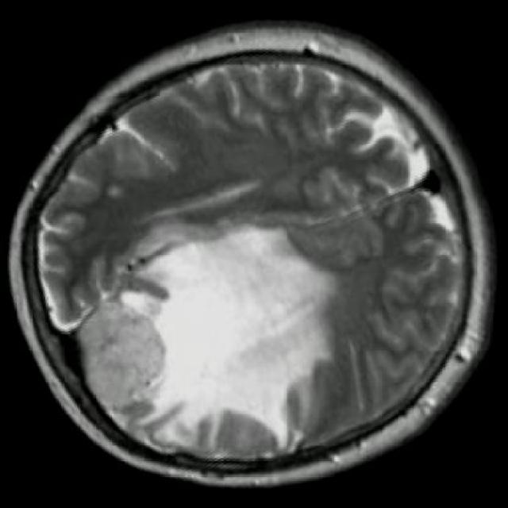
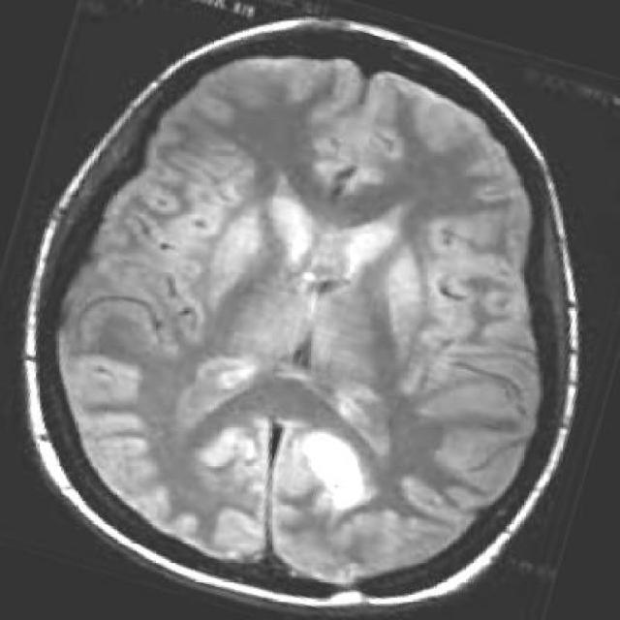
Results include bounding box visualizations over MRI scans highlighting tumor locations. Thees

Slide 17
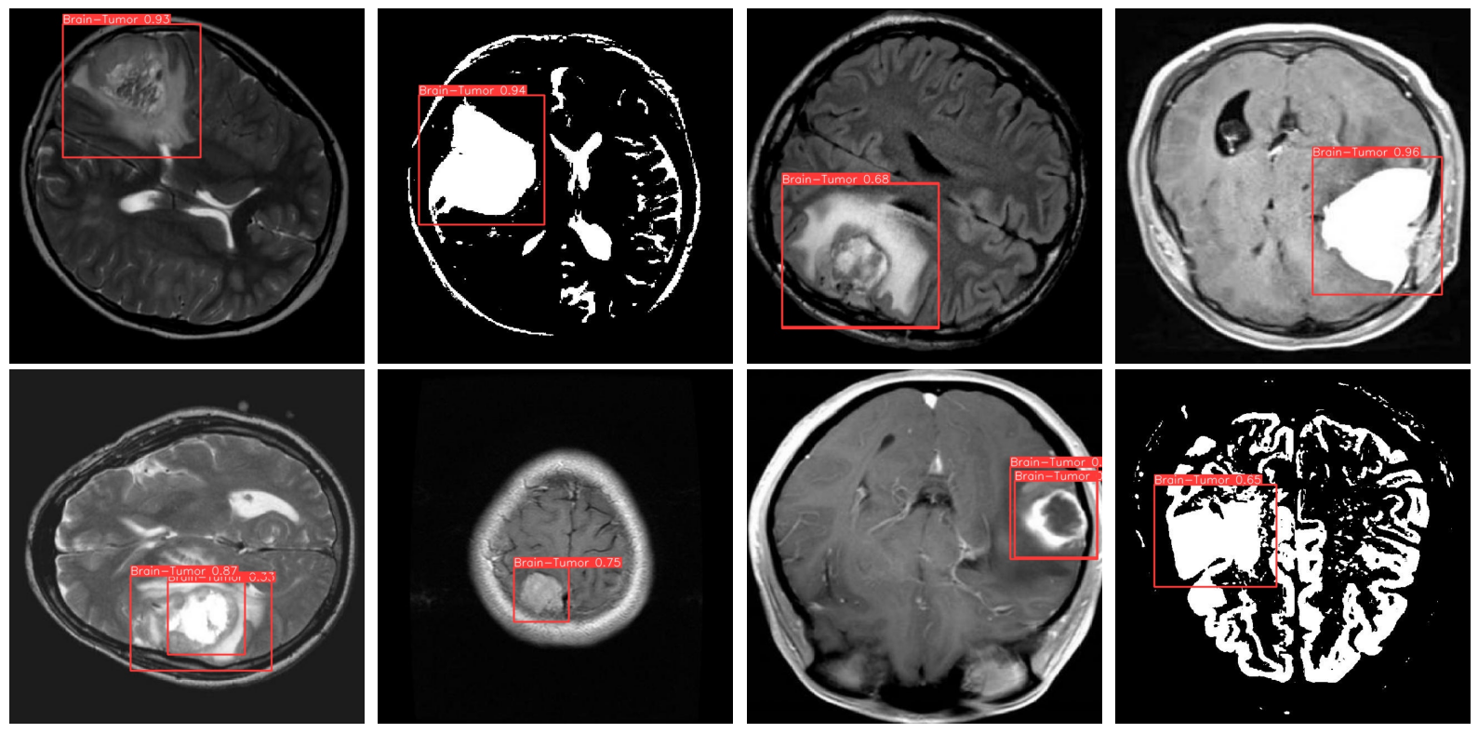
SEGMENTATION OUTPUT VISUALIZATION :
Detected Tumor on MRI Scans:
YOLOv10n successfully identifies and localizes brain tumors with bounding boxes on MRI images.
Accurate tumor localization across various sizes, shapes, and intensities.
Bounding Box Output:
Tumors are enclosed within clearly defined bounding boxes.
Helps radiologists quickly identify regions of interest.
Confidence scores displayed with each detection.

Slide 18
CHALLENGES FACED :
Dataset Quality and Quantity:
Limited number of annotated MRI scans.
Imbalance in tumor types and sizes.
Variation in image quality and resolution impacted training consistency.
Model Convergence Issues:
Initial training showed slow convergence and overfitting tendencies.
Required fine-tuning of learning rate, batch size, and augmentation techniques.
Addressed using data augmentation and early stopping.
Annotation Errors:
Some ground truth bounding boxes were inaccurately labeled or misaligned.
Manual correction and verification of labels was time-consuming.
Introduced slight noise in training performance.
Hardware Constraints (if applicable):
Training on high-resolution medical images required significant GPU memory.
Batch size was limited due to hardware constraints, impacting training speed.

Slide 19
APPLICATIONS AND USECASES :
Clinical Diagnosis Support:
Assists radiologists by automatically detecting and highlighting tumor regions in MRI scans.
Reduces manual workload and human error in diagnosis.
Enables faster and more consistent interpretation of brain scans.
Remote Health Monitoring:
Can be integrated into telemedicine platforms for remote diagnostics.
Useful for rural or underserved areas where access to expert radiologists is limited.
Facilitates second-opinion diagnostics via automated tools.
Integration into Hospital Systems:
Seamless deployment into PACS (Picture Archiving and Communication Systems).
Can trigger alerts for abnormal scans and prioritize urgent cases.
Enhances workflow in radiology departments.
Medical Research and Tumor Analysis:
Enables large-scale tumor data analysis and visualization.
Supports research on tumor growth, behavior, and treatment response.

Slide 20
FUTURE WORK :
Incorporating 3D MRI Data:
Current model processes 2D slices; moving to 3D volume analysis would provide more contextual understanding.
Potential to increase detection accuracy by considering spatial relationships between slices.
Real-time Detection Deployment:
Optimize the model for edge devices and hospital PACS integration.
Deploy as a web or mobile-based application for on-the-fly tumor detection.
Further Model Optimization:
Experiment with quantization and pruning for lightweight deployment.
Fine-tune hyperparameters and anchors for specific tumor types.
Multi-class Segmentation:
Extend model to classify different tumor types (e.g., glioma, meningioma, pituitary).
Use instance segmentation or hybrid models (e.g., YOLO + Mask R-CNN).
Clinical Validation and Trials:
Collaborate with hospitals for real-world testing and feedback.
Validate against expert-labeled datasets for medical approval and trust.

Slide 21
CONCLUSION :
Designed and implemented a brain tumor segmentation model using YOLOv10n, optimized for real-time medical applications.
Reduced manual diagnostic effort and potential human error through automation.
Enabled faster diagnosis and real-time processing, making it practical for deployment in clinical settings.
Validated YOLOv10n as a lightweight yet powerful alternative to traditional segmentation models like U-Net or Faster R-CNN.
Accurate segmentation plays a crucial role in treatment planning and patient outcomes.
Deep learning, when carefully optimized and trained, can match or even exceed traditional diagnostic methods.
The model's speed and scalability make it ideal for both hospitals and remote health monitoring systems.

Slide 22
THANK YOU

